Slide 1
Module 8.8
Intrusion Detection

Slide 2
Intrusion detection
Many intrusion detection systems
Close to 100 systems with current web pages
Network-based, host-based, or combination
Two basic models
Misuse detection model
Maintain data on known attacks
Look for activity with corresponding signatures
Anomaly detection model
Try to figure out what is “normal”
Report anomalous behavior
Fundamental problem: too many false alarms

Slide 3

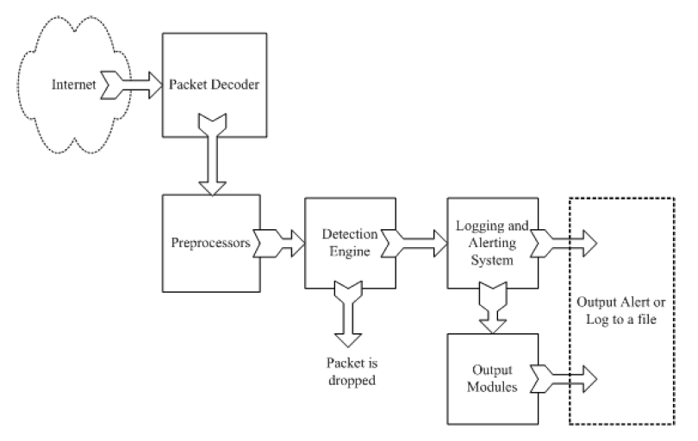
Example: Snort
http://www.snort.org/
From: Rafeeq Ur Rehman, Intrusion Detection Systems with Snort: Advanced IDS Techniques with Snort, Apache, MySQL, PHP, and ACID.

Slide 4
Snort components
Packet Decoder
input from Ethernet, SLIP, PPP…
Preprocessor:
detect anomalies in packet headers
packet defragmentation
decode HTTP URI
reassemble TCP streams
Detection Engine: applies rules to packets
Logging and Alerting System
Output Modules: alerts, log, other output

Slide 5
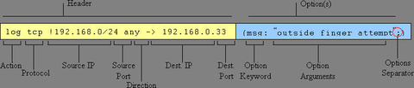
Snort detection rules
rule header
rule options

Slide 6

Additional examples
destination ip address
Apply to all ip packets
Destination port
Source ip address
Source port #
Rule options
Alert will be generated if criteria met

Slide 7
Snort challenges
Misuse detection – avoid known intrusions
Database size continues to grow
Snort version 2.3.2 had 2,600 rules
Snort spends 80% of time doing string match
Anomaly detection – identify new attacks
Probability of detection is low

Slide 8
Difficulties in anomaly detection
Lack of training data
Lots of “normal” network, system call data
Little data containing realistic attacks, anomalies
Data drift
Statistical methods detect changes in behavior
Attacker can attack gradually and incrementally
Main characteristics not well understood
By many measures, attack may be within bounds of “normal” range of activities
False identifications are very costly
Sys Admin spend many hours examining evidence

